Slide 1

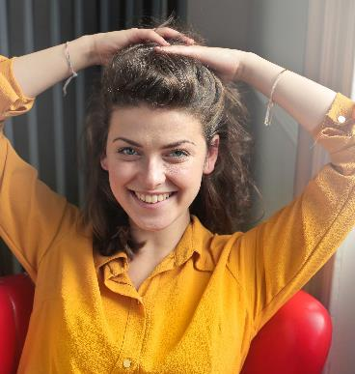
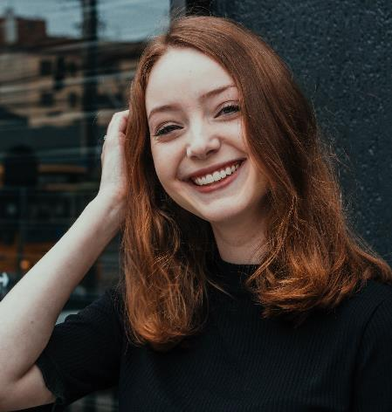
MY FRIEND
Арсалиева Э.Х., ст.преподаватель ЧГПУ

Slide 2
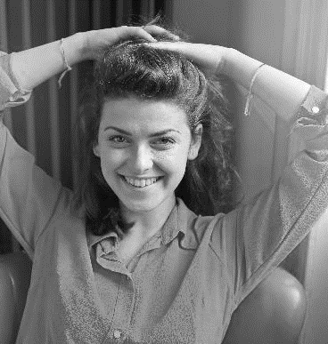
I would like to tell you about my friends. I have a lot of them, but my close friend is Marina. She is my school-mate.

Slide 3

We have been studying together in one form all the eleven years of our school-life. She is 17. We have nothing in common in appearance. Marina is pretty in her own way. She is thin and slender, not very tall. Her hair is red and straight, her face is oval and her forehead is high. She has a turn-up nose and beautiful green eyes with bushy eyelashes.

Slide 4
Marina is as good as gold. Warm-hearted and gentle, quiet and well-bred. Everyone loves her. She is always well dressed and neat. She is always ready to help people, when they are in need.

Slide 5
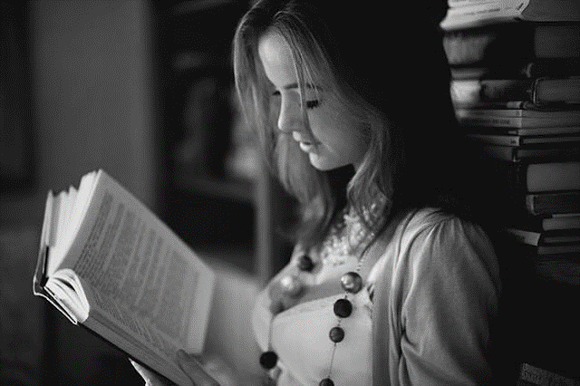
Marina is the only daughter of her parents and they adore her. Nevertheless she is not selfish.
I like to be around her, because she knows a lot of interesting stories, funny jokes. She is fond of reading.

Slide 6
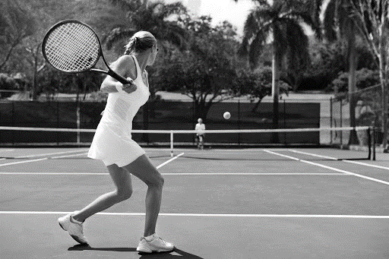
Marina goes in for sports. She plays tennis and swims. She does well at school and it seems to me that all the subjects come equally easy to her. This year she is leaving school and has chosen medicine as future profession. I hope she will make a good doctor.

Slide 7
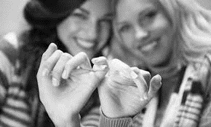
I am happy to have such a friend as Marina. I am sure we shall be friends forever.

Slide 8
Questions:
What is your friend’s name?
How old is she?
Is she pretty? Describe her appearance.
Is she always dressed well?
How does she do at school?
Does she go in for sports?
What hobbies does she have?
Why is she your best friend?

Slide 9
Источник:
100 тем английского языка. Авторы Каверина В. Бойко В. Жидких Н.
https://teachershelp.ru
https://reedcafe.ru/sites/all/themes/books/images/how-read-more.jpg
https://encrypted-tbn0.gstatic.com/images

