Slide 1
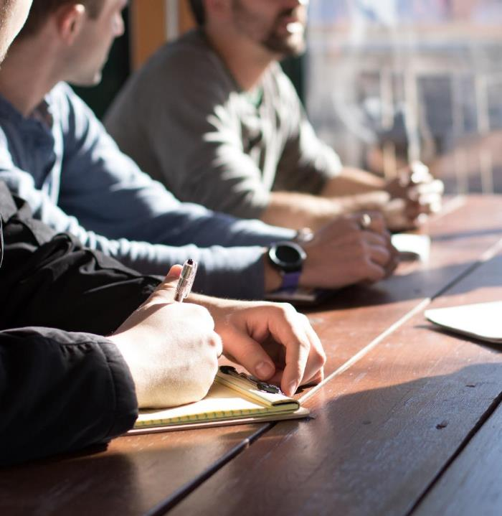
MY WORKING DAY
Арсалиева Э.Х., ст.преподаватель ЧГПУ

Slide 2
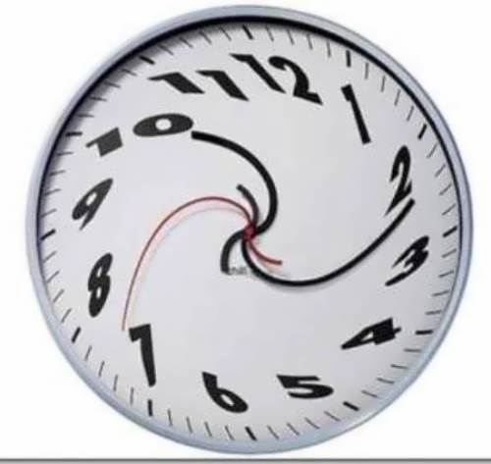
I am very busy on my weekdays. My weekdays do not differ much one from another.
On weekdays my working day begins early in the morning. My school starts at 8 о’clock, so I have to get up at 7, to be ready in time. I never wake up myself, my mother always wakes me up.
2

Slide 3
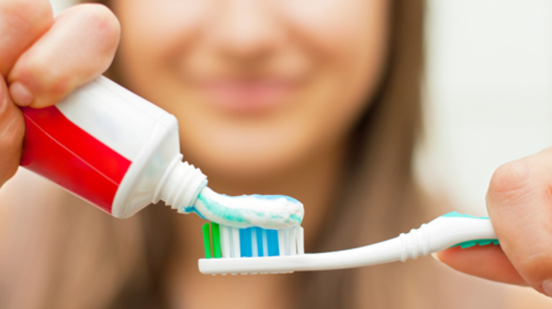
Sometimes I do my morning exercises, then I rush to the bathroom. I clean my teeth, wash my face. The cold water makes me feel not so sleepy. Then I go back to my room, make the bed. I put on my clothes, comb my hair, put a little makeups. By that time my breakfast is ready (my mother cooks it for me).
3

Slide 4

At a quarter to eight I grab my bag and rush to my school. My school starts at 8 o’clock and I don’t like to be late.
Usually I have six or seven lessons a day, it lasts till 3 o’clock. After each lesson there is a break, so I can talk to my friends or eat my sandwich. When school is over I go home.
4

Slide 5
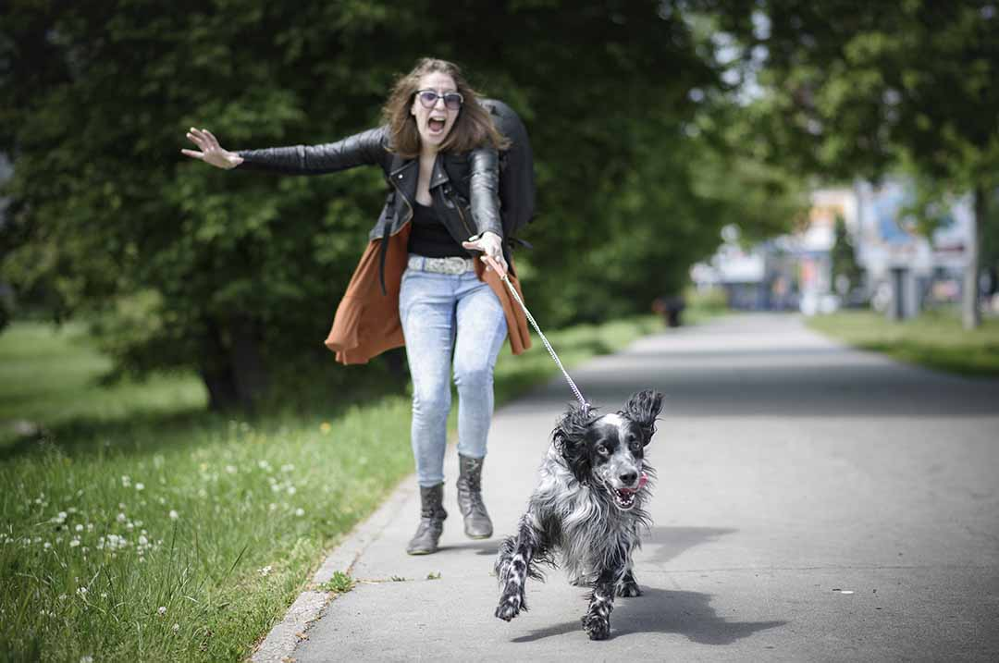
First of all I need to walk my dog. Then I have my dinner and a little rest.
5

Slide 6


The teachers give us a lot of homework, so I start doing it about 16.30 or 17.00. As a rule it takes me two or three hours to do my home assignments.
6

Slide 7
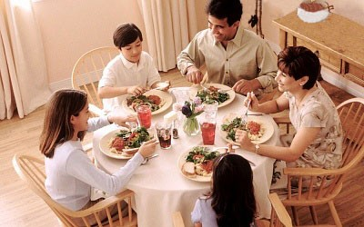
My parents get home about six o’clock. We watch soap — opera on TV, have supper together. We share all the news, I tell about the lessons and school.
7
7

Slide 8
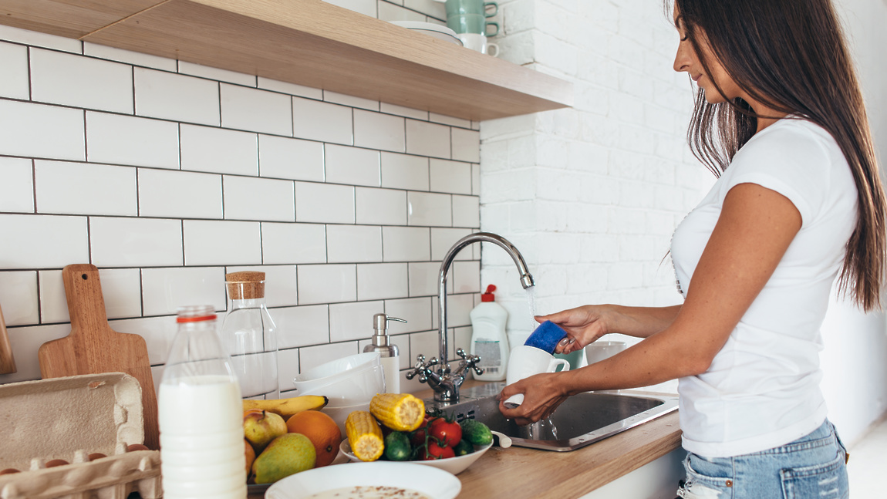
After it, I help my mother to do some work about the house — wash dishes, sweep the floor, clean the room.
8

Slide 9
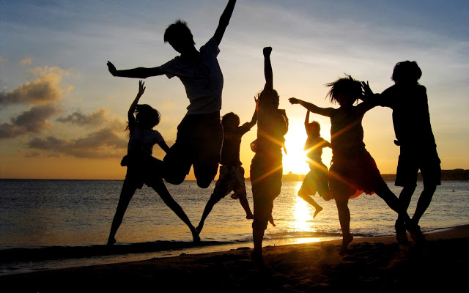
Twice a week in evenings I go play tennis. When I do not go to play tennis,
I stay home and watch TV, listen to the music, read magazines.
Sometimes my friends call me and we go for a walk.
9

Slide 10


At eleven o’clock tired after a long working day I go to bed and fall asleep.
10

Slide 11
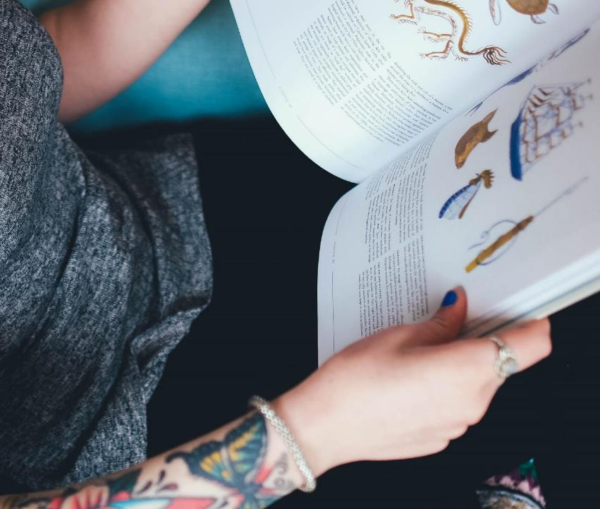

Questions:
1. What time do you get up on your week-days?
2. Do you usually do your morning exercises?
3. Who cooks your breakfast?
4. What time do you leave your house to go to school?
5. How many lessons do you have a day?
6. Do you usually do your homework?
7. What do you do in the evening?
8. What time do you go to bed?
11

Slide 12
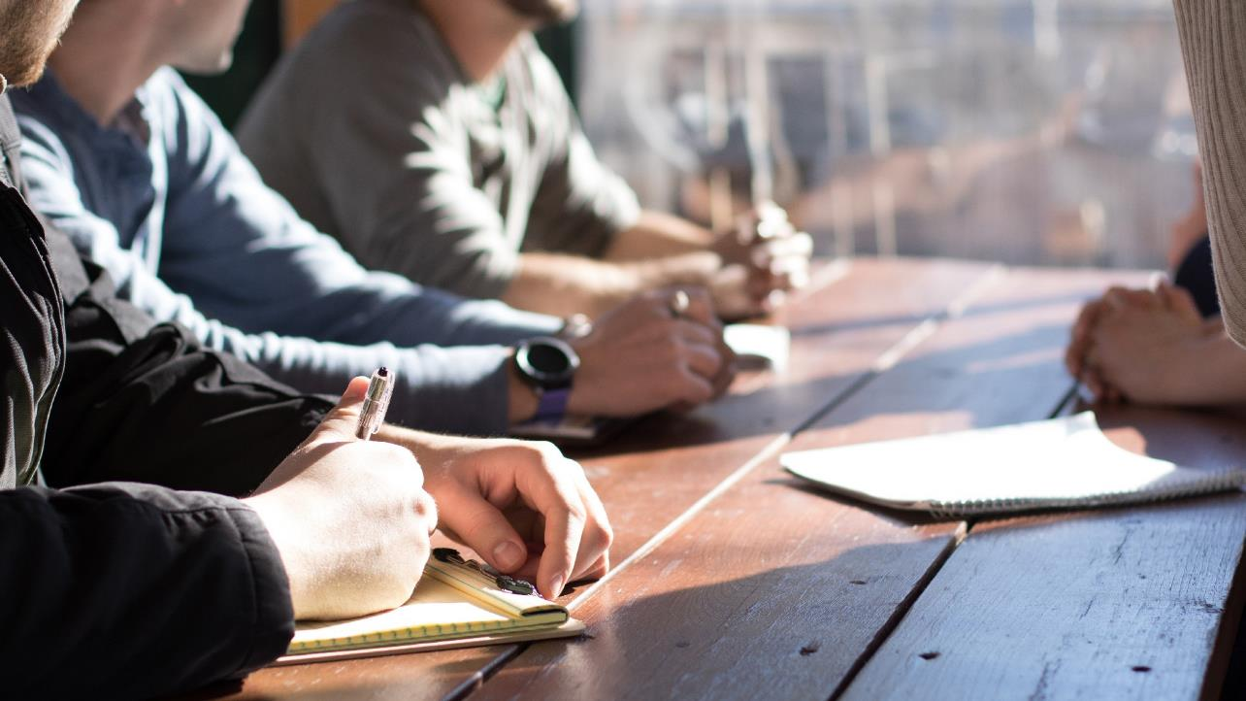
Источники:
https://teachershelp.ru/my-working-day/
https://img.tsn.ua/cached/1551113662/tsn-9eec32dc4989e3515edf3aa709da07a2/thumbs/1340x530/f7/ba/6fef8be06ab4628d2aa8a7b7ba2bbaf7.jpeg
https://radio1.news/files/image/06/29/60/-lg!0e2c.jpg
https://podrobnosti.ua/media/pictures/2017/1/29/thumbs/740x415/chasto-chistit-zuby-vredno_rect_caaac6a02884fb7714bb1d9f561ce5ca.png
https://encrypted-tbn0.gstatic.com/images?q=tbn%3AANd9GcQ5L2OwwwDxrnE61hkJCzgSNOfr7lZBqHbv-3z6c4AnJX5LuvBa&usqp=CAU
https://sonnik-online.com/wp-content/uploads/2018/04/drusya.jpg
12

