Slide 1
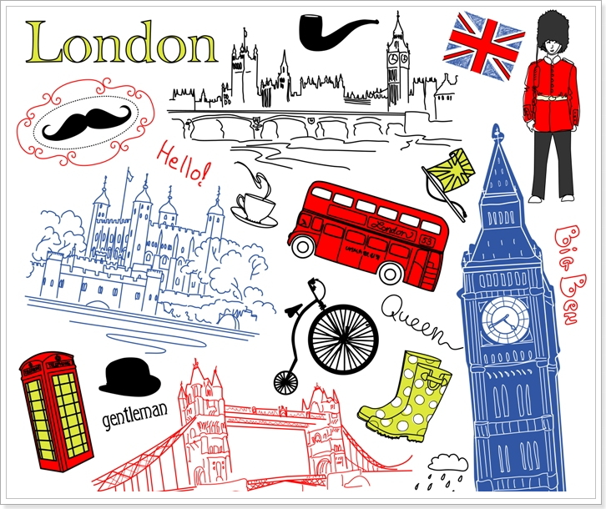
London

Slide 2
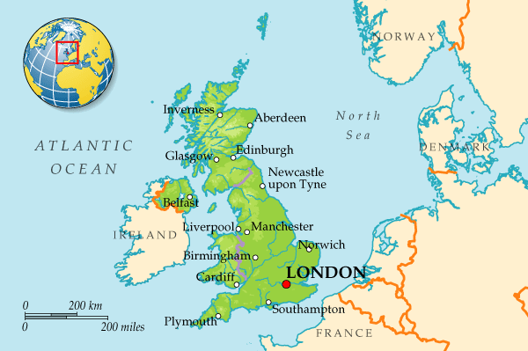
London is the capital of Great Britain. It is a political, economic and cultural centre.

Slide 3
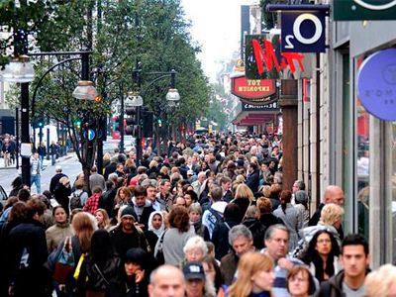
It’s one of the largest cities in the world.
Its population is more than 9 million people.

Slide 4
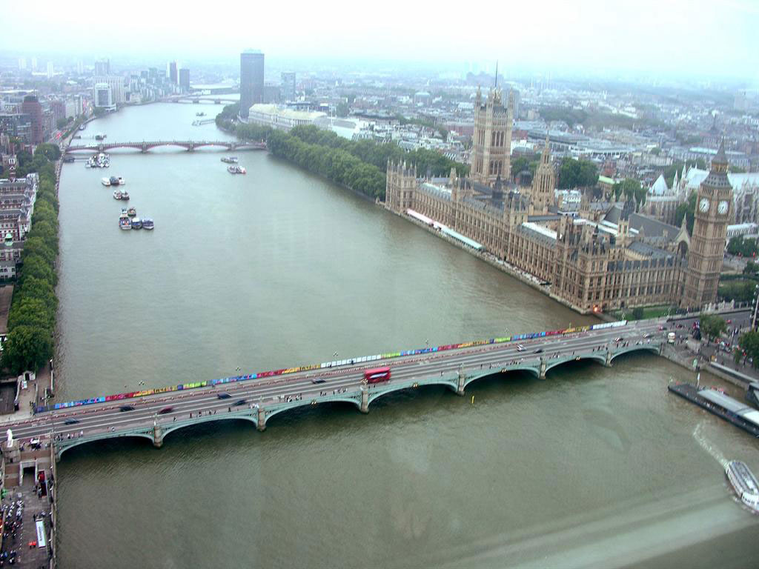
London is situated on the river Thames.

Slide 5
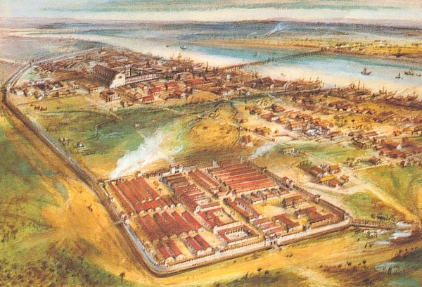
It was founded more than two thousand years ago.
London is an ancient city. It appeared at the place where the Roman invaders decided to build a bridge over the Thames.

Slide 6
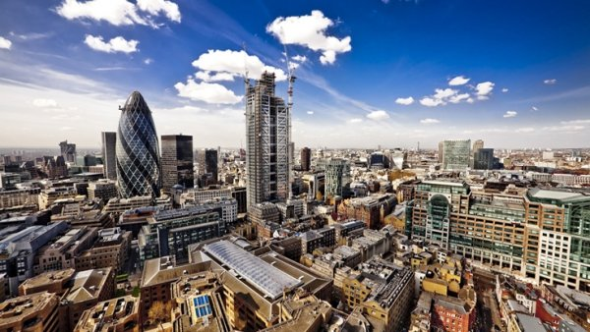
There are four parts in London: West End, East End, the City and Westminster.

Slide 7
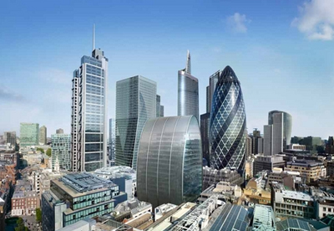
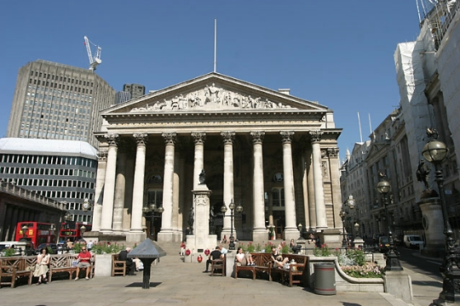
The City is the oldest part of London, its financial and business centre. There are many offices, companies and banks in this part of the capital. The heart of the City is the Stock Exchange.

Slide 8
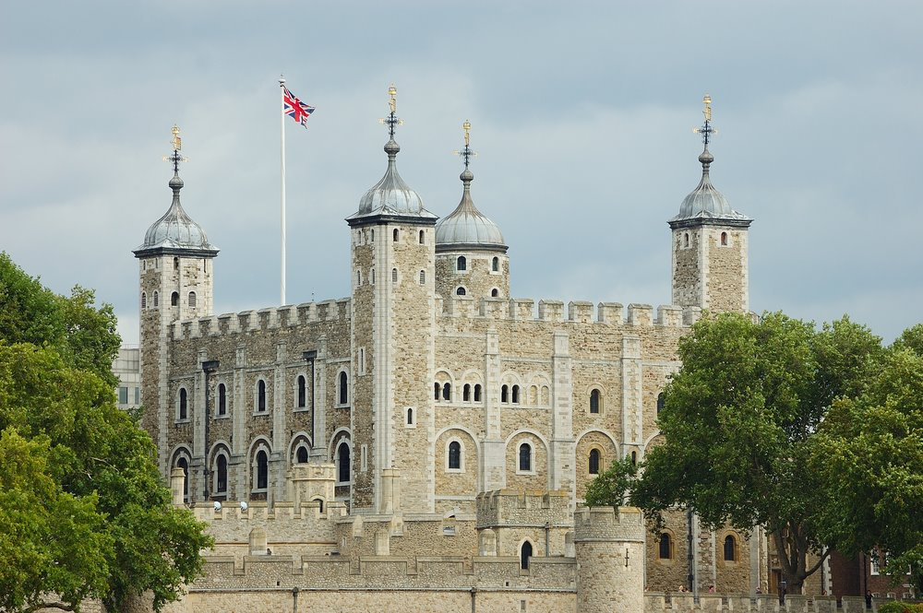
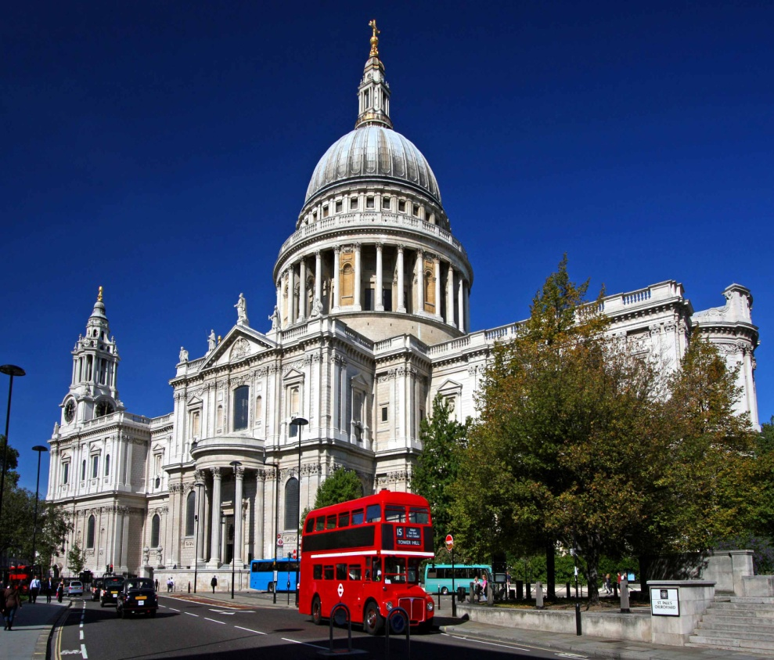
The Tower of London and St Paul’s Cathedral are situated in the City

Slide 9
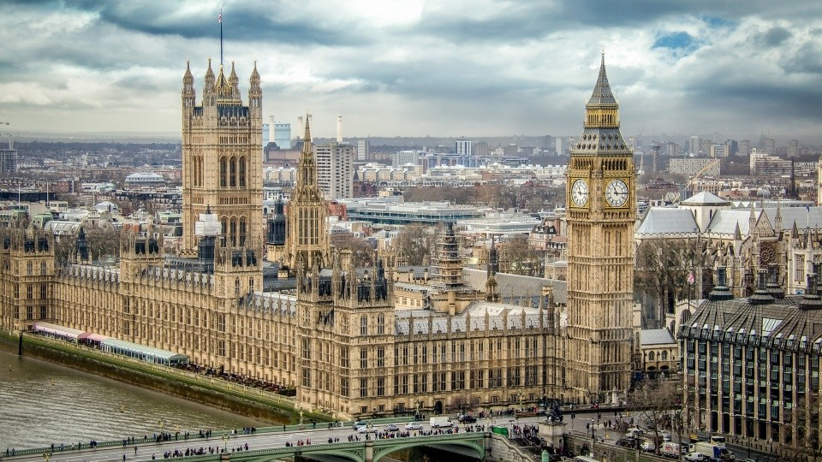
Westminster is also important part of the capital. It’s the administrative centre of London.
The Houses of Parliament, the seat of the British Government, are there.

Slide 10
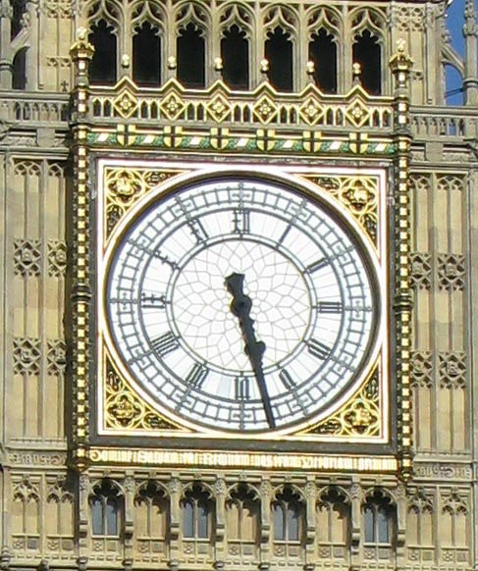
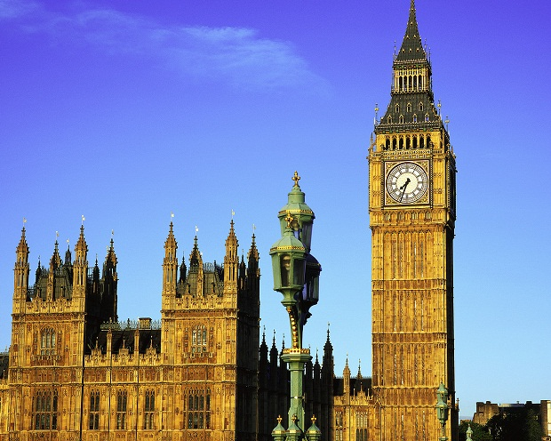
The Towers of the Houses of Parliament stand high above the city. On the highest tower there is the largest clock in the country, Big Ben. Big Ben strikes every quarter of an hour.

Slide 11
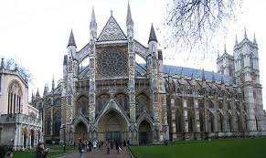
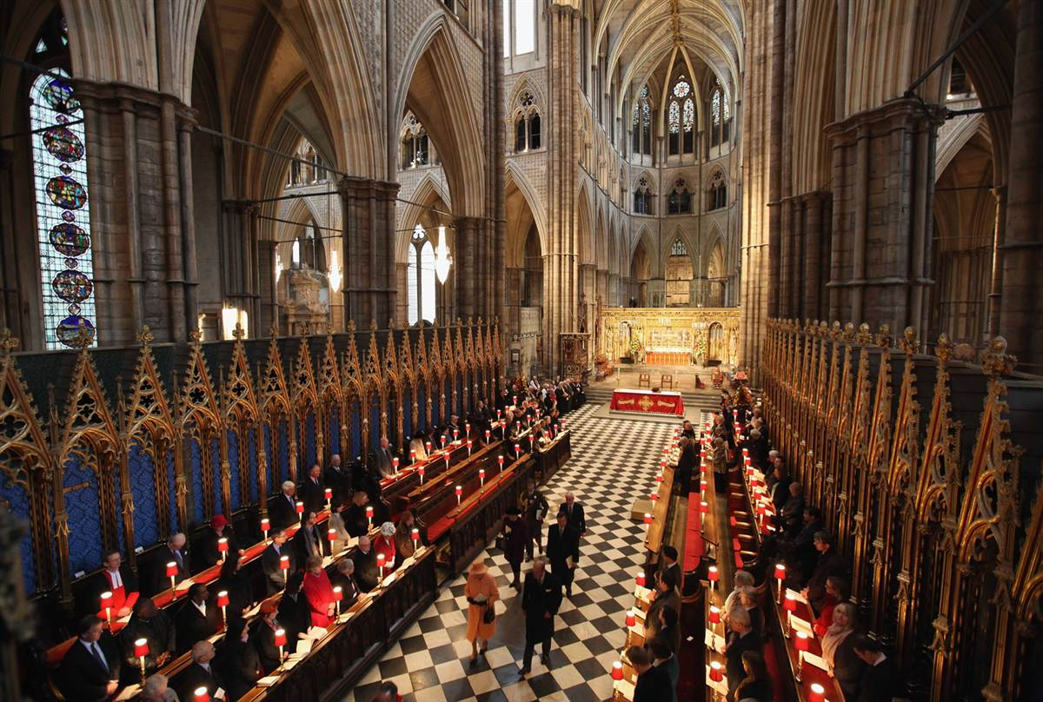
Opposite the Houses of Parliament is Westminster Abbey where kings and queens have been crowned and many famous people were buried.

Slide 12
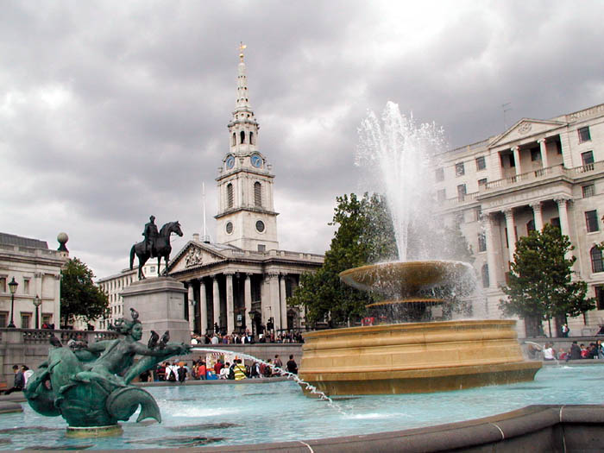
West End is the richest part of London. It is full of luxury hotels, super-markets, cinemas and concert-halls. In the centre of the West End is the Trafalgar Square with the famous statue of Lord Nelson.

Slide 13
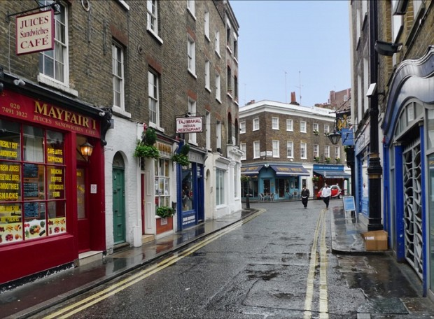
East End is an industrial district of the capital. Most of plants and factories are situated there.

Slide 14
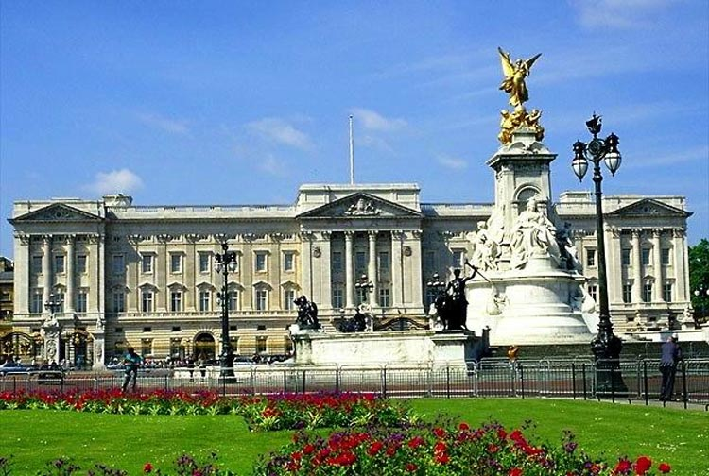
The official London residence of the Queen is Buckingham Palace. The palace was built in 1703 by the Duke Buckingham
.

Slide 15
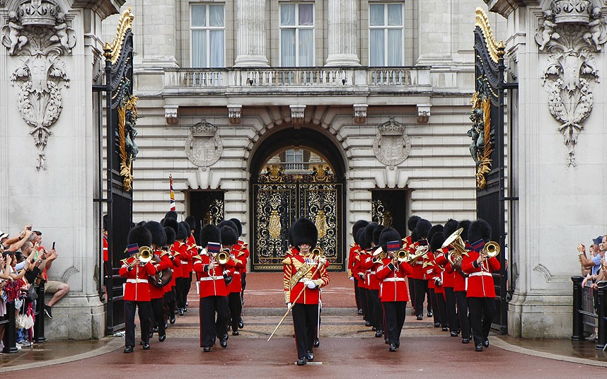
The daily ceremony of the Changing of the Guard takes place in its courtyard.

Slide 16
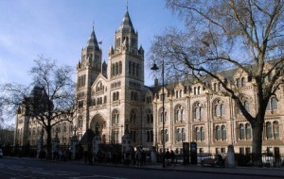
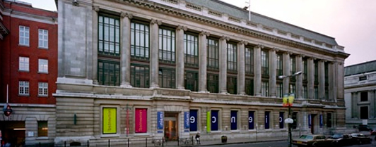
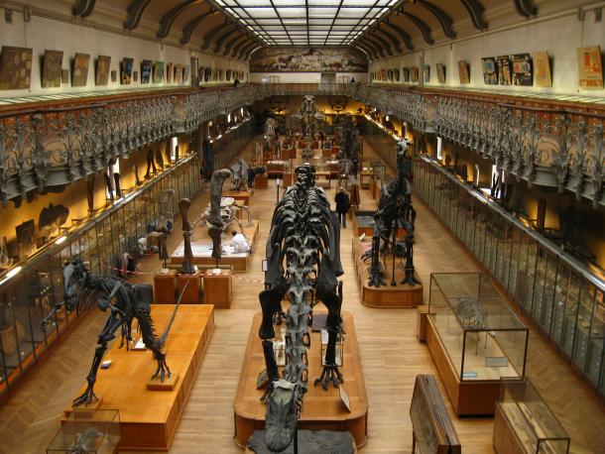
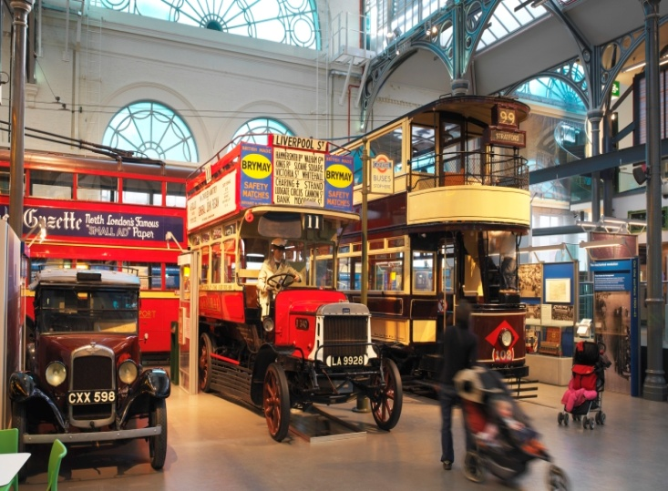
There are many museums in London. For example, the Natural History Museum, the Science Museum.

Slide 17
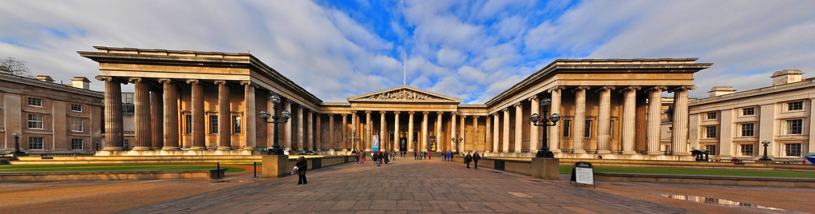
The British Museum is the biggest museum in London. The museum is famous for its library — one of the richest in the world.

Slide 18
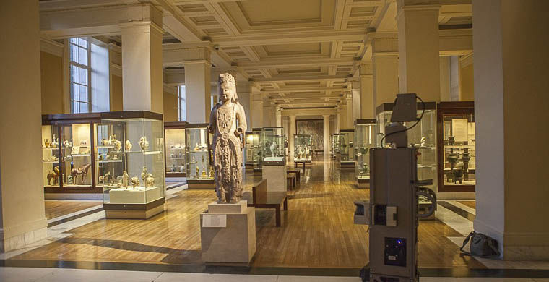
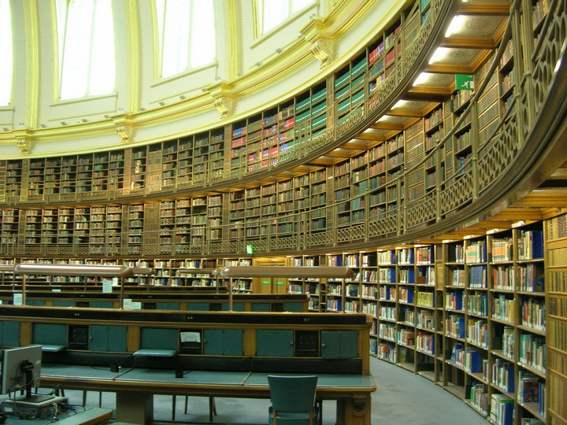

Slide 19
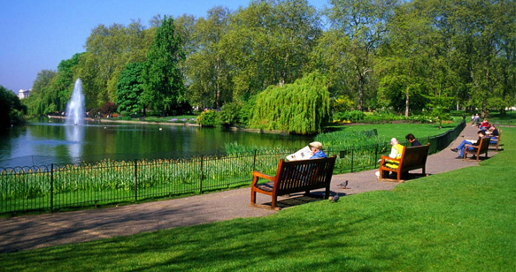
There are many beautiful parks in London.
St James’s Park, Green Park, Hyde Park, and Kensington Gardens are linked together and form above 300 hectares of parkland in the heart of London

